Slide 1

Block-Chain Educational Courses

Slide 2
What is block-chain ?
A blockchain is a distributed ledger technology that allows data to be stored in a decentralized manner.
It is essentially a chain of blocks that contain data (transactions, records, etc.) and is maintained by a network of computers (or nodes) to ensure security and integrity.
Blockchains are the underlying infrastructure for many digital currencies (like Bitcoin and Ethereum) and decentralized applications (dApps).

Slide 3
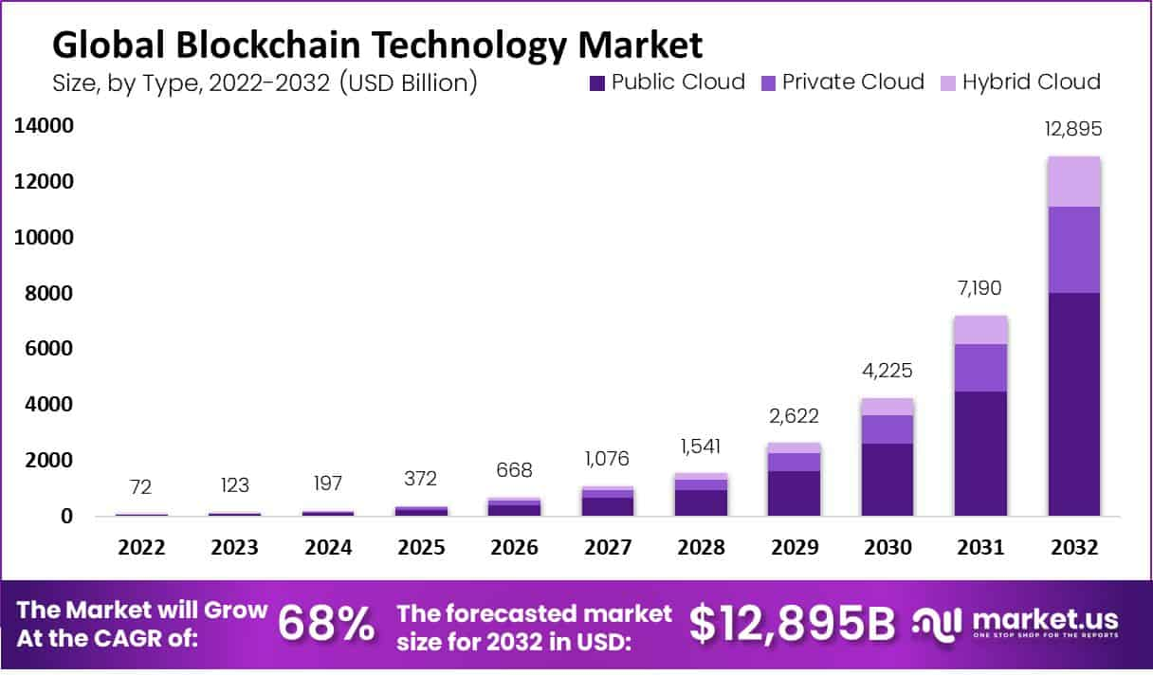
Blockchain Market Overview: Blockchain Market size is forecast to reach USD 12,895 Billion by 2033, from USD 123 Billion in 2023, growing at a CAGR of 68% during the forecast period from 2024 to 2033.

Slide 4
Blockchain Educational Courses Category Overview
Trends:
Growing interest in blockchain technology and cryptocurrencies.
High demand for skilled blockchain professionals.
Emergence of online learning platforms.
Need for accessible and high-quality educational resources.
Challenges:
Rapidly evolving technology can make content outdated quickly.
Identifying and partnering with credible educators.
Competition from existing online learning platforms and free resources.
Maintaining content relevance and accuracy.
Opportunities:
Tap into a growing market of learners.
Offer specialized courses catering to specific career paths (e.g., DeFi, NFTs, Web3 development).
Build a community of blockchain enthusiasts.
Generate revenue through paid courses, certifications, and corporate training.

Slide 5
Vision and Mission
Vision To become the leading platform for accessible, up-to-date, and high-quality blockchain education, empowering individuals to build careers in blockchain technology and innovation.
Mission To make blockchain education universally accessible by offering engaging, affordable courses led by industry experts, cultivating a supportive learning community, and empowering individuals to thrive in the dynamic blockchain ecosystem.

Slide 6
Content Plan
Content Strategy:
Focus on high-quality, in-depth content: Leverage expert instructors, interactive elements (quizzes, simulations), and real-world case studies.
Cater to diverse learning styles: Offer a variety of formats (video lectures, articles, infographics, interactive tutorials).
Prioritize practical skills: Focus on hands-on learning with coding exercises, projects, and real-world application scenarios.
Stay current: Regularly update content to reflect the latest industry trends and developments.

Slide 7
Content Calendar for three months
Week 1-2:
Article: “What is Blockchain? A Beginner’s Guide”
Video: “Blockchain Demystified: Key Concepts You Need to Know”
Week 3-4:
Interview: “Building the Future of Blockchain: Insights from a Leading Developer”
Report: “Blockchain Trends to Watch in 2025: What’s Next for the Industry?”
Week 5-6:
Webinar: “How to Start a Career in Blockchain: A Step-by-Step Guide”
Article: “Blockchain in the Real World: Case Studies from DeFi to Supply Chain”
Week 7-8:
Course Review: “Top Blockchain Courses to Get You Started in 2025”
Infographic: “Blockchain and Cryptocurrency Explained in 5 Simple Steps”
Week 9-12:
Blog Post: “How Blockchain is Changing the Healthcare Industry”
Tutorial Video: “Creating Your First Smart Contract: A Beginner’s Guide”

Slide 8
Initial 5 Content Pieces:
“What is Blockchain? A Beginner’s Guide":
A comprehensive introduction to blockchain technology, explaining its basic principles,
types (public vs. private blockchains), and real-world applications.
2. “Blockchain Demystified: Key Concepts You Need to Know":
A video that covers core blockchain concepts like decentralization, consensus algorithms (PoW, PoS),
and cryptographic techniques, with visual explanations.
3. "Building the Future of Blockchain: Insights from a Leading Developer":
An expert interview with a blockchain developer, discussing trends, challenges,
and career advice for aspiring professionals in the field.

Slide 9
4."Blockchain Trends to Watch in 2025: What’s Next for the Industry?":
A research report analyzing blockchain trends like interoperability, scalability solutions,
and the growing influence of Web3 and DeFi.
5."Blockchain in the Real World: Case Studies from DeFi to Supply Chain":
A blog post detailing real-life applications of blockchain, from decentralized finance platforms to
supply chain tracking, highlighting how blockchain is solving industry problems.

Slide 10
Community Building Strategy
Social Media Platforms:
Establish a strong presence on platforms like Twitter, LinkedIn, and Facebook.
Share engaging content, interact with followers, and run targeted ad campaigns.
Utilize relevant hashtags and participate in relevant online communities.
Telegram/Discord:
Create dedicated channels for discussions, Q&A sessions, and announcements.
Host online events and workshops.
Facilitate peer-to-peer learning and networking opportunities.

Slide 11
LinkedIn:
Publish thought leadership articles and engage with industry professionals.
Build a network of blockchain experts and recruiters.
Host online events and webinars.
Partnerships:
Collaborate with blockchain companies, universities, and industry associations.
Cross-promote content and events with partner organizations.
Offer exclusive content and discounts to members of partner communities

Slide 12
Community Engagement Ideas:
Weekly AMA sessions: Host live Q&A sessions with blockchain experts and industry leaders.
Online hackathons: Organize online coding challenges and competitions.
Community-driven projects: Encourage community members to contribute to open-source projects or work on collaborative projects.
Scholarship programs: Offer scholarships to deserving students to support their blockchain education.
Networking events: Organize virtual or in-person networking events for community members.

Slide 13
Revenue Generation Plan
Paid Courses: Offer premium access to in-depth courses and specialized programs.
Certifications: Provide industry-recognized certifications for course completion.
Corporate Training: Develop customized training programs for businesses looking to adopt blockchain technology.
Sponsored Content: Partner with blockchain companies to create sponsored content (e.g., blog posts, webinars, case studies).
Partnerships:
Affiliate marketing: Partner with other online learning platforms and earn commissions on referrals.
Content partnerships: Collaborate with blockchain companies to create joint content and share revenue.
Corporate partnerships: Offer exclusive training programs and consulting services to corporate clients

Slide 14
Strategy to approach potential client:
Research and identify potential partners: Focus on companies and organizations aligned with the platform's mission and target audience.
Develop compelling value propositions: Clearly articulate the benefits of partnering with your platform.
Build relationships: Network with potential partners at industry events and conferences.
Create professional proposals: Present well-researched and persuasive proposals outlining the partnership terms and benefits.
Negotiate and finalize agreements: Ensure that all parties are satisfied with the terms of the partnership.

Slide 15
Performance Metrics
KPIs:
Website Traffic: Number of unique visitors, page views, bounce rate, time on site
Content Engagement: Number of views, likes, shares, comments, and downloads
Community Growth: Number of subscribers, followers, and active members
Course Enrolments & Completion Rates: Number of students enrolled, completion rates, and course ratings
Revenue: Total revenue generated, revenue per student, and customer lifetime value
Brand Awareness: Brand mentions, social media reach, and media coverage

Slide 16
Data-Driven Insights:
Analyse website traffic data to understand user behaviour and identify areas for improvement.
Track content engagement metrics to identify the most popular and effective content formats.
Monitor community activity to gauge audience interests and identify areas for improvement.
Analyse course completion rates and student feedback to improve course quality and delivery.
Use revenue data to evaluate the effectiveness of different revenue streams and optimize pricing strategies.
Regularly review and adjust the content strategy and marketing initiatives based on data-driven insights.

Slide 17
Articles on Blockchain
What is Blockchain(McKinsey & Company)- https://www.mckinsey.com/featured-insights/mckinsey-explainers/what-is-blockchain
Using blockchain to drive supply chain transparency(Deloitte)- https://www2.deloitte.com/us/en/pages/operations/articles/blockchain-supply-chain-innovation.html
Blockchain Facts(Investopedia)-https://www.investopedia.com/terms/b/blockchain.asp

Slide 18
Courses Example on Blockchain
Blockchain, Blockchain Basics, Blockchain Revolution(Coursera)- https://www.coursera.org/courses?query=blockchain
Blockchain Specialization(Harvard)- https://tech.seas.harvard.edu/free-blockchain
Get started with blockchain development(Microsoft)- https://learn.microsoft.com/en-us/training/paths/ethereum-blockchain-development/
Blockchain(IBM)- https://skillsbuild.org/students/course-catalog/blockchain
101 Blockchains(101 Blockchains)-https://101blockchains.com/courses/

Slide 19
Hackathons Examples
Devposts- https://devpost.com/c/blockchain
Hacker Earth- https://www.hackerearth.com/hackathon/explore/field/blockchain/
DoraHacks- https://dorahacks.io/hackathon
ETHGlobal - https://ethglobal.com/
Substrate- https://substrate.io/ecosystem/opportunities/hackathons/

Slide 20
Thank You
Name- Ritesh Singh
Email- ritesh147singh@gmail.com
Contact- +91 8541975513

